Slide 1
COMP30810 Intro to Text Analytics
Dr. Binh Thanh Le
thanhbinh.le@ucd.ie
Insight Centre for Data Analytics
School of Computer Science
University College Dublin

Slide 2
Today Goals:
Understand Dimensionality Reduction
Understand Feature Extraction / Selection
Understand: What / When / Why to use Feature Reduction

Slide 3
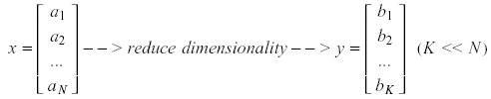
What is Dimensionality Reduction?
Significant improvements can be achieved by first mapping the data into a lower-dimensional space.
Dimensionality can be reduced by:
Combining features using a linear or non-linear transformations.
Selecting a subset of features (i.e., feature selection).

Slide 4

Why Dimensionality Reduction?
Some features may be irrelevant
We want to visualize high dimensional data
“Intrinsic” dimensionality may be smaller than the number of features

Slide 5
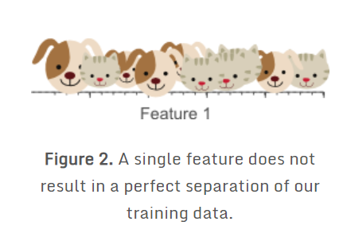
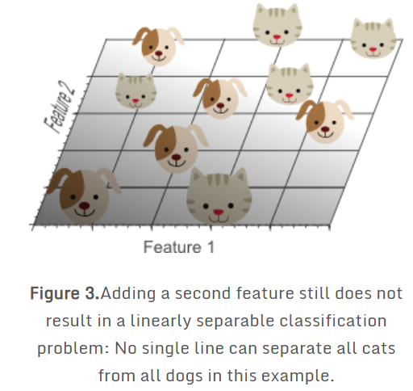
Curse of Dimensionality
Figure 2 shows that we do not obtain a perfect classification result if only a single feature <Feature1> is used.
➔ Add another feature <Feature2>
e.g. the average ‘green’ color in the image

Slide 6
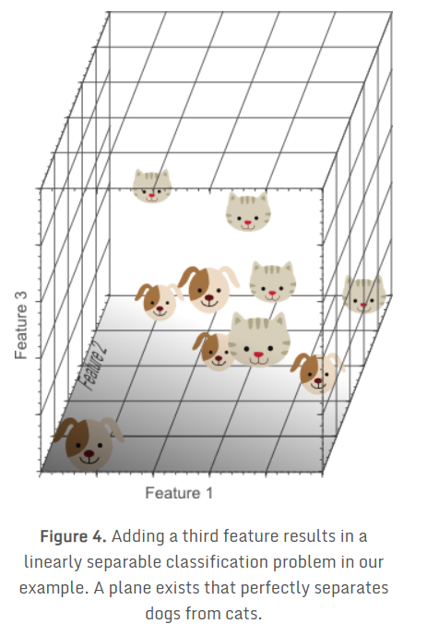
Curse of Dimensionality
Add a third feature <Feature3>
E.g. the average ‘blue’ color in the image,
→ three-dimensional feature space

Slide 7
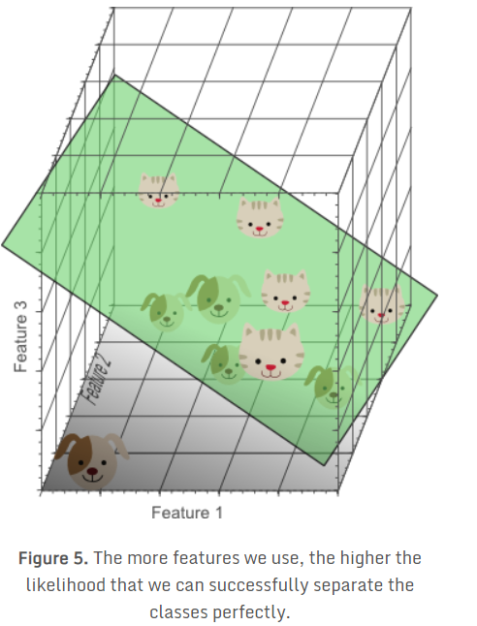
Curse of Dimensionality
Now, can find a plane that perfectly separates dogs from cats.
This means that a linear combination of the three features can be used to obtain perfect classification results on our training data of 10 images.

Slide 8
Curse of Dimensionality
If we would keep adding features, the dimensionality of the feature space grows, and becomes sparser and sparser.
Due to this sparsity, it becomes much easier to find a separable hyperplane.

Slide 9
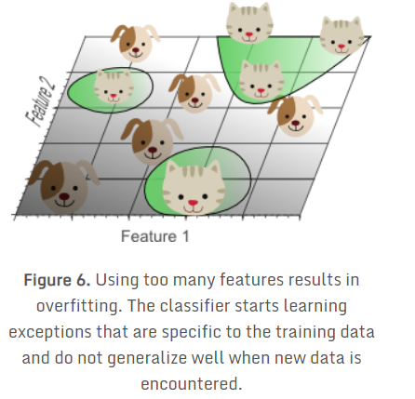
Curse of Dimensionality
However, if we project the highly dimensional classification result back to a lower dimensional space, a serious problem associated with this approach becomes evident
The resulting classifier would fail on real-world data, consisting of an infinite amount of unseen cats and dogs.
OVERFITTING
This concept is called overfitting and is a direct result of the Curse of Dimensionality.

Slide 10
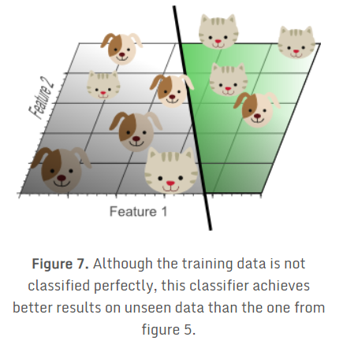
Curse of Dimensionality

Slide 11
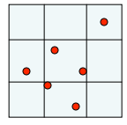
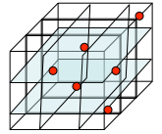
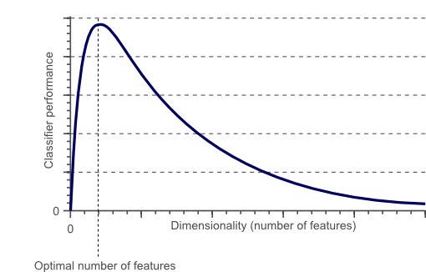
Curse of Dimensionality
Same number of examples
Fill more of the available space
Back to the performance when the dimensionality is low
Increase more #dimensions, while keep #samples → Overfitting → Performance decrease

Slide 12
What about Text Data ?
While we tend to think of columns or features as dimensions, the text data works a bit differently.
In text, every word or term becomes a dimension - it can get to 10000s of dimensions quickly.
Just trying to find what topic a paragraph of text has, you are probably looking at 50 to 100 dimensions right there !
Therefore text models need a lot of data to train with!
When doing classification on some unknown piece of text, the models that you use are probably trained on a large corpus of data to minimize the effects of the Curse of Dimensionality.

Slide 13
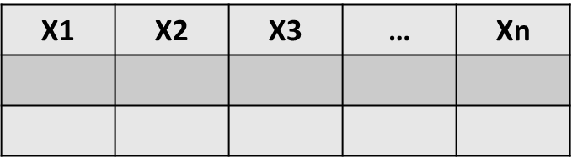
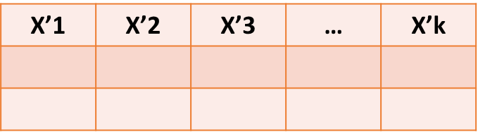
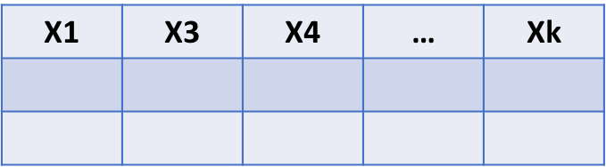
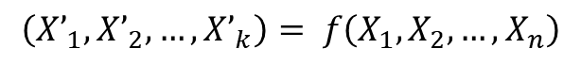
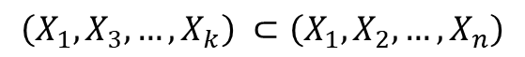
Extraction vs Selection
Feature Extraction
Feature Selection
The key difference between feature selection and extraction is that feature selection keeps a subset of the original features while feature extraction creates brand new ones.

Slide 14
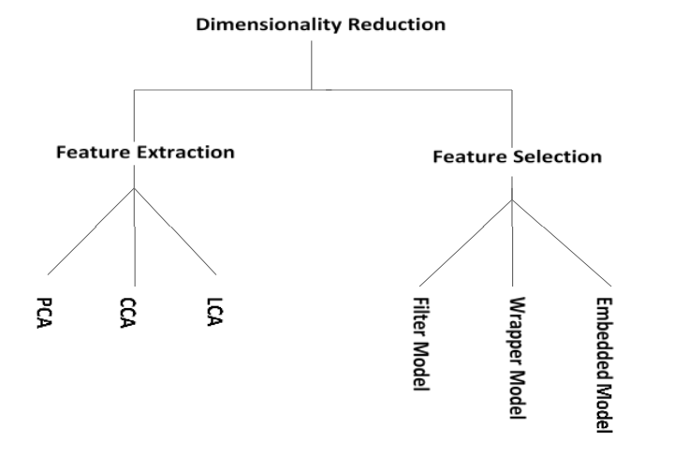
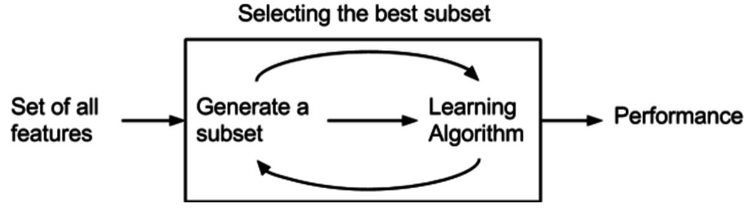
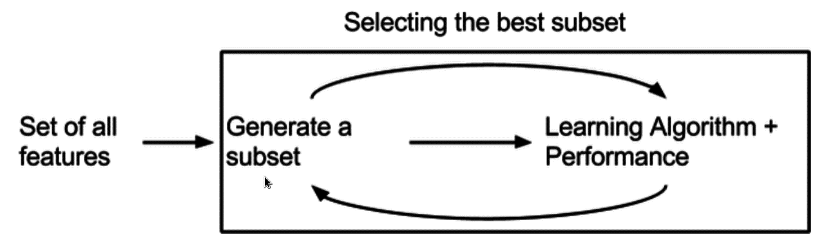
Sample techniques
Filter method
Evaluation methods:
Accuracy / Probabilities with cross-validation
Mean Square Error
Weighted cost
Information gain / Entropy
…
Wrapper method
Embedded method

Slide 15
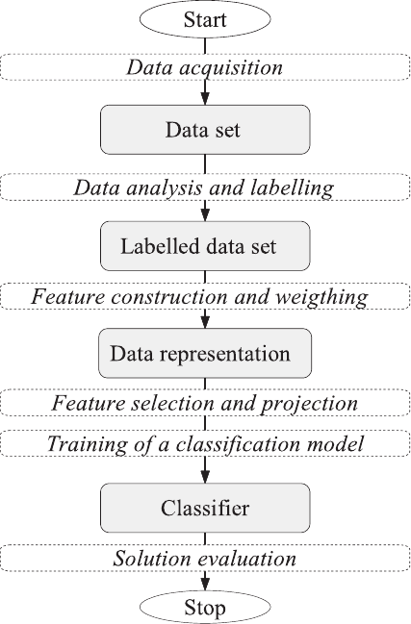
Questions:
Feature selection → Split train|test ?
Normalization → Feature selection?
Flowchart of the text classiﬁcation process

Slide 16

Principle Component Analysis (PCA)
Key idea: Generate the component axes that maximize the variance of data

Slide 17

Principle Component Analysis (PCA)
Key idea: Generate the component axes that maximize the variance of data
https://plot.ly/ipython-notebooks/principal-component-analysis/
http://www.cs.otago.ac.nz/cosc453/student_tutorials/principal_components.pdf

Slide 18
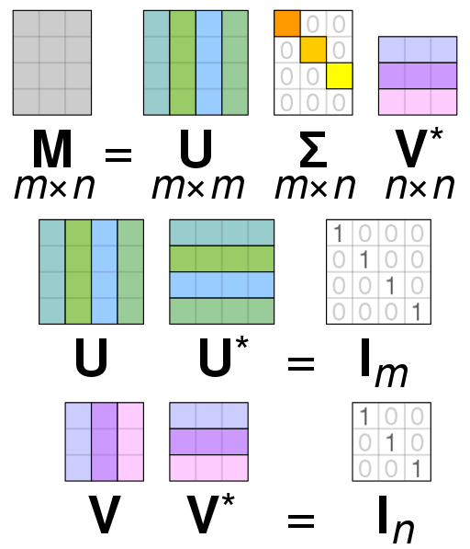
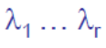
Latent Semantic Analysis (LSA) (aka Truncated SVD)
U : (m × m) Orthogonal Eigenvectors of MM^{T}
Σ : diagonal (m × n) matrix with non-negative real numbers on the diagonal → Eigenvalues
V : (n × n) Orthogonal Eigenvectors of M^{T}M
Now, we truncate:
https://blog.applied.ai/feature-reduction-using-svd/
http://cs229.stanford.edu/proj2017/final-reports/5163902.pdf
https://www.nmr.mgh.harvard.edu/PMI/toolbox/Documentation/tsvd.xhtml

Slide 19
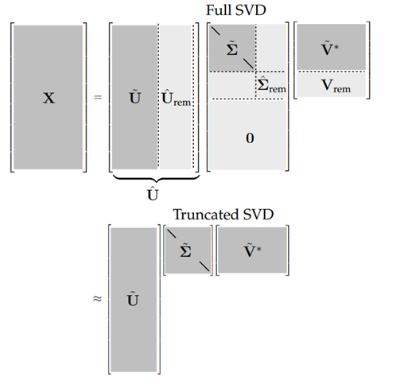
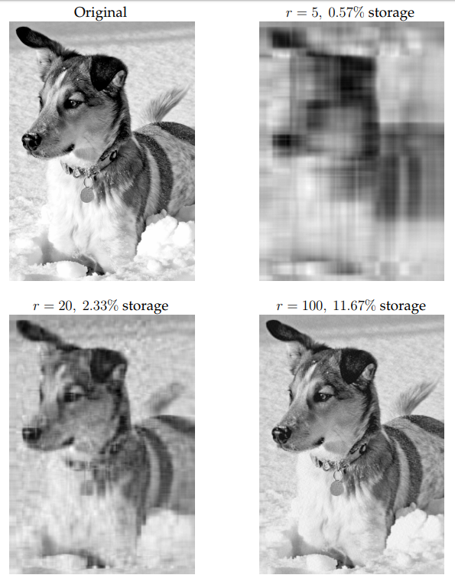
Latent Semantic Analysis (LSA) (aka Truncated SVD)
Now, we truncate:

Slide 20
Summary
We use Feature Extraction / Selection when:
Avoid the Curse of Dimensionality
Transform features
Set up the consistent feature space for data
Have a visualization for data

